Slide 1

CMR COLLEGE OF ENGINEERING & TECHNOLOGY
Kandlakoya, Medchal, Hyderabad - 501401
Department of Computer Science and Engineering
SUICIDAL TWEETS DETECTION USING MACHINE LEARNING
Batch No:13
Name of the student
G.Akshaya (20H51A05C3)
K.Sushmaraj (20H51A05L0)
P.Akshitha (20H51A05L5)
Under esteemed guidance of
Ms.J.Spandana(Assistant Professor)
Batch: 2020-2024

Slide 2
Outline
Abstract
Introduction
Literature survey
Existing system
- Problems in existing system
Research Objective of Presentation
Problem Definition
Research work
-Proposed system architecture
-Methods
Performance Measure
Results
Conclusion
Future work
References
Notes:
2

Slide 3
Abstract
Notes:
3

Slide 4
ABSTRACT
Suicidal ideathon is basically to think about talking one’s own life and is related to Mental health problems, but people with mental disorder, insecurity, stress and a sense of Losing control receive no treatment for their condition due to the limited accessibility to Mental care facilities, awareness or social support
In this research, we have also used Several sets of embedded and tweet features, and we have compared our model among Twelve classifiers models. The results from our study reflect that our proposed model can Accurately predict the target outcome and come up with an excellent standard for suicidal Ideathon prediction on active social media such as Twitter

Slide 5
INTRODUCTION
Notes:
5

Slide 6
Introduction
Social media with its mental health-related forums has become an emerging study area in computational linguistics. It provides a valuable research platform for the development of new technological approaches and improvements which can bring a novelty in suicide detection and further suicide risk prevention.
The primary objective of our study is to share the knowledge of suicide ideation in Reddit social media forums from a data analysis perspective using effective architectures.
Our main task is to explore the potential of Long Short-Term Memory (LSTM),
Convolutional Neural Network (CNN) and their combined model applied in
multiple classification tasks for suicide ideation struggles.
Notes:
6

Slide 7
Literature Survey
Notes:
7

Slide 8
Existing system
TEXT-BASED SYSTEM
The text-based system is designed to play a pivotal role in identifying individuals at risk of suicide by analyzing their written or textual expressions. Leveraging advanced natural language processing (NLP) techniques, this system aims to detect subtle yet significant cues in text data that may indicate emotional distress, hopelessness, or suicidal ideation.
IMAGE AND VIDEO ANALYSIS
Image and video analysis in suicidal recognition is an evolving field that leverages visual data to identify potential signs of suicidal thoughts or self-harming behavior in individuals. This area of research and technology aims to assist in early intervention and support for individuals at risk of self-harm or suicide. Here's an introductory overview of how image and video analysis is applied .
Notes:
8

Slide 9
Research Objective
Notes:
9

Slide 10
Research objective
This research objective aims to create a robust system that can accurately identify tweets based on their words features, thereby improving the overall
management of feeds in recognition settings.
The system may have applications in ensuring the correct matching of tweets with their past words or similarities, enhancing security measures in neonatal units, and streamlining threat processes such as message tracking and suicidal recognition.

Slide 11
Problem Definition
Notes:
11

Slide 12
Problem Definition
Understanding the context used by individuals who express suicidal ideation on social media, and developing algorithms that can accurately interpret and analyze this content.
Identifying relevant websites and social media messages where individuals may express suicidal thoughts.
Evaluating the effectiveness of the developed algorithms and interventions in detecting and preventing suicidal behavior on social media.

Slide 13
Research Work
Notes:
13

Slide 14
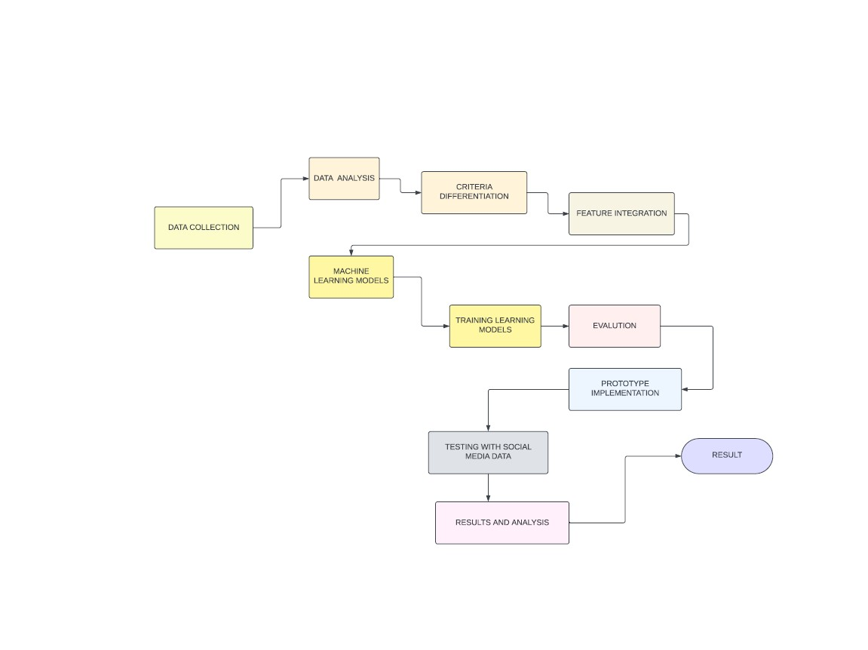
Proposed system architecture

Slide 15
Data collection:
The suggested study trains an approach for suicidal thoughts detection using
Information obtained from Twitter. First, a list of tweets from people seeking for help from the online community was created from suicide-related statements. Since the writers of these messages are typically individuals with suicidal thoughts, these posts may be regarded as suicide-indicative statements.
Data Preparation:
Information collected from twitter cannot be straightforwardly utilized for include extraction due to the nearness of different clamors that are predominant within the crude information. This causes issues in word coordinating and semantic This causes issues in word planning and semantic investigation.
Eliminating Halt words:
Halt words like 'a', 'an', 'the', etc. are expelled as they are not discriminative or valuable for our show. Information preprocessing and clamor expulsion result within the expulsion of boisterous substance from the information and deliver a high-quality and solid dataset that can be utilized in this think about.

Slide 16

Proposed Methods
Implementation of Machine Learning Algorithms
Decision Tree Algorithm
Decision Choice Tree could be a Administered learning procedure that can be utilized for both classification and Relapse issues, but for the most part it is preferred for fathoming Classification issues
Support Vector Machine Algorithm
The goal of SVM is to decide the most excellent line or choice boundary that can isolated a multidimensional space into distinctive classes
Naive Bayes Algorithm
Naive Bayes classifiers are a collection of classification calculations based on Bayes' Hypothesis

Slide 17
Random Forest Regression
The unpredictable timberland approach utiling bootstrapping incorporates the utilize of various choice trees made from the data and combined through gathering learning methods. This procedure regularly leads to specific figures and classifications by averaging the comes around of the erratically chosen trees

Slide 18
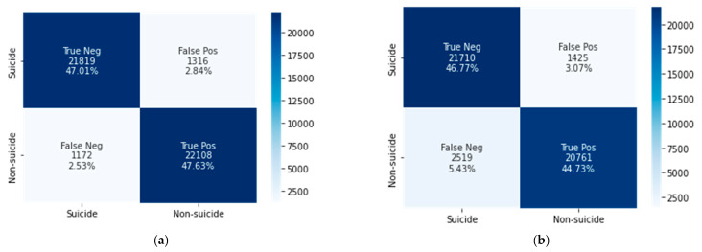
Performance Measure:
Classification of suicide and non-suicide

Slide 19
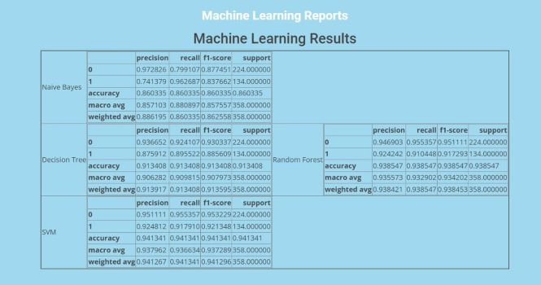
Result Analysis

Slide 20
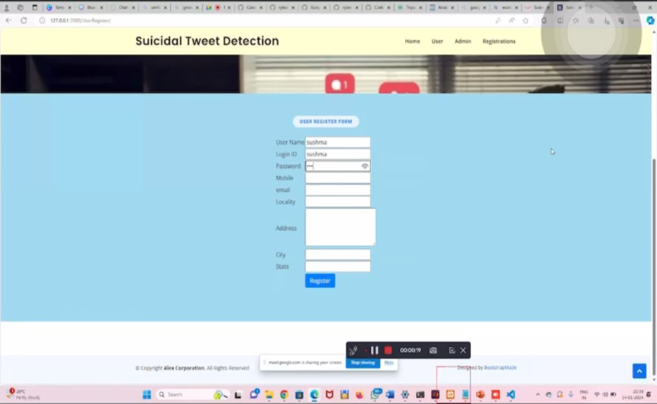
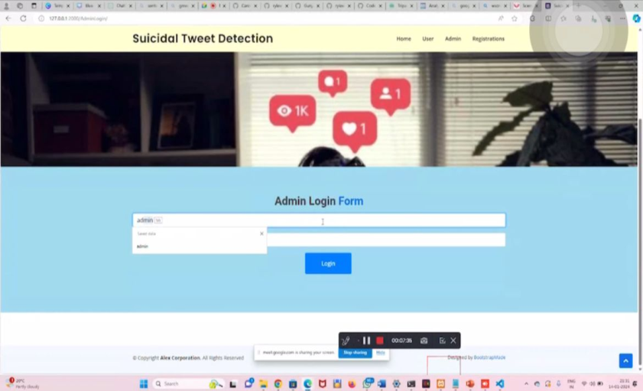
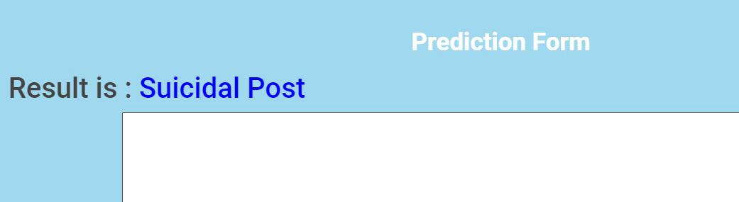
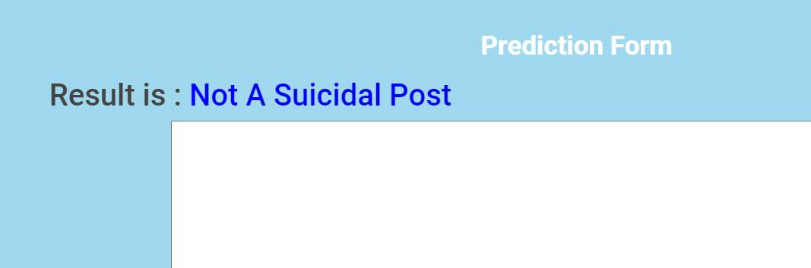
User Registration Form
User Login Form
Initially the user need to be registered by filling the necessary details in the registration form

Slide 21
Conclusion
In conclusion, In this study, we developed and evaluated a suicide ideation detection system using ML and hybrid DL techniques to evaluate Reddit user’s psychological states. Our experimental results showed that the CNN–BiLSTM model outperformed the XG Boost model, achieving 95% accuracy in detecting suicidal ideation using textual features, compared with the latter’s 91.5% accuracy.
Our analysis using the LIWC lexicon reveals that suicidal posts score higher on authenticity, anxiety, mentality, depression, negativity, and sentimental despondency and lower on attention, mind-thinking, perception, sociality, and cognitive processes than non-suicidal posts.

Slide 22
Future work
In the future, we schedule to improve the system for checking web pages for suicidal content namely:
1.Add images verification as these images may be suicidal or contain symbols of
death groups. The last one may be an indication that the website containing it belongs to this group.
2.Add links verification on the page as they may be related to relevant websites.
3.Add checking for suicidal instructions. We also going to to improve this method in the future by analyzing more machine learning algorithms and text processing libraries

Slide 23
References
[1] F. M. Shah, F. Haque, R. U. Nur, S. Al Jahan, and Z. Mamud, “A hybridized highlight extraction approach to self destructive ideation revelation from social media post,” in 2020 IEEE Region 10 Symposium (TENSYMP). IEEE, 2020, pp. 985–988.
[2] A. T. Beck, M. Kovacs, and A. Weissman, “Assessment of self-destructive consider: the scale for suicide ideation.” Journal of counseling and clinical brain inquire.
[3] M. K. Nock, G. Borges, E. J. Bromet, C. B. Cha, R. C. Kessler, and S. Lee, “Suicide and self-destructive behavior,” Epidemiologic overviews, vol. 30, no. 1, pp. 133–154, 2008

Slide 24
Thank You!

